Slide 1
Week 6 Updates Shapiro
By Evan Johns

Slide 2
Agenda
Week 5 Review
Radial distance decisions
Delta matrix calculations
Box Plots of cells Neutrophil neighborhood
Neighborhood Plot
Delta Neighborhood Plot
Statistical Significance
Neutrophil Distance Calculations
Methodology
Results

Slide 3

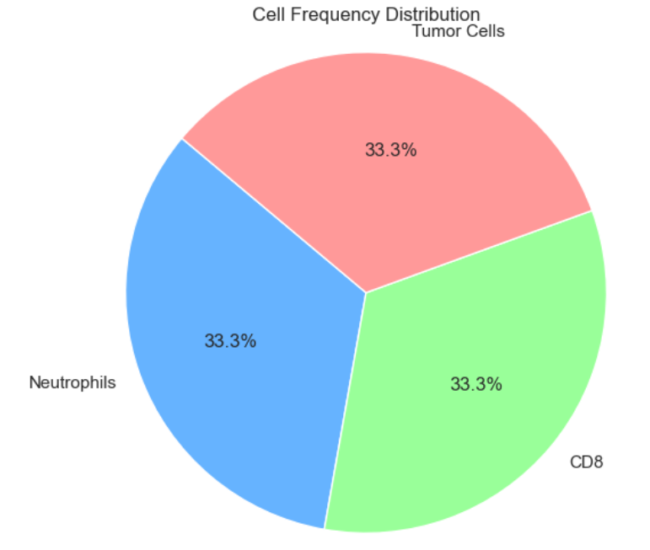
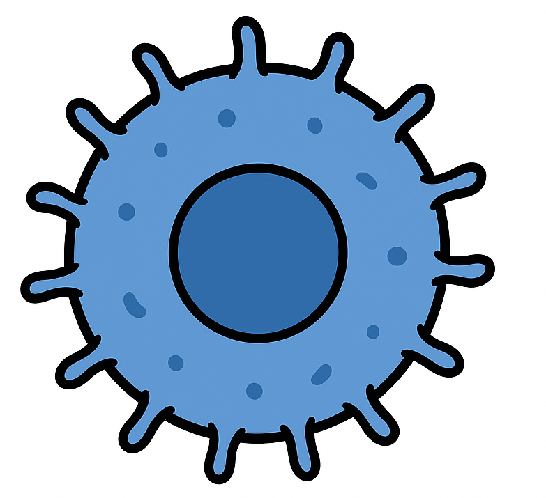

Radial Distance – Example Methodology
Note that PMN cells do not count themselves in this relationship to prevent double counting.
Everything in radius is counted equally.
15 µm is the most common value used in literature.
PMN
15 µm
CD8+ T-Cell
Tumor Cell
PMN

Slide 4
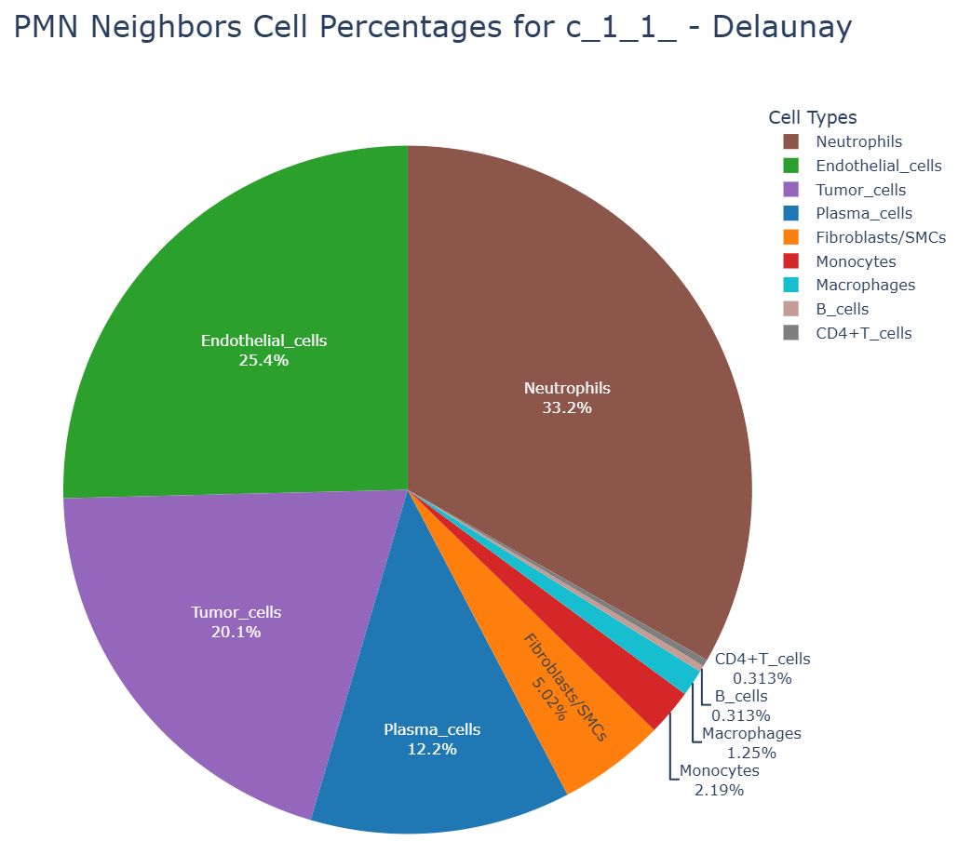
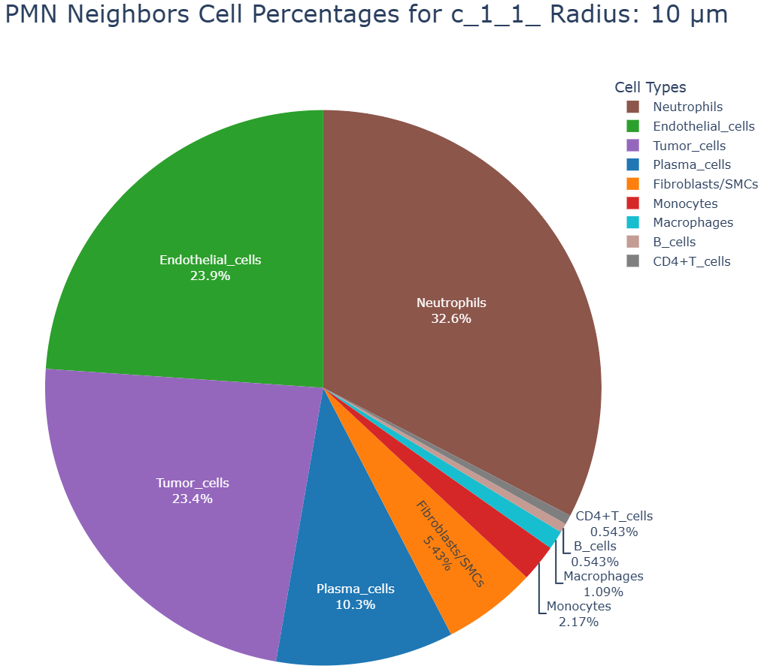
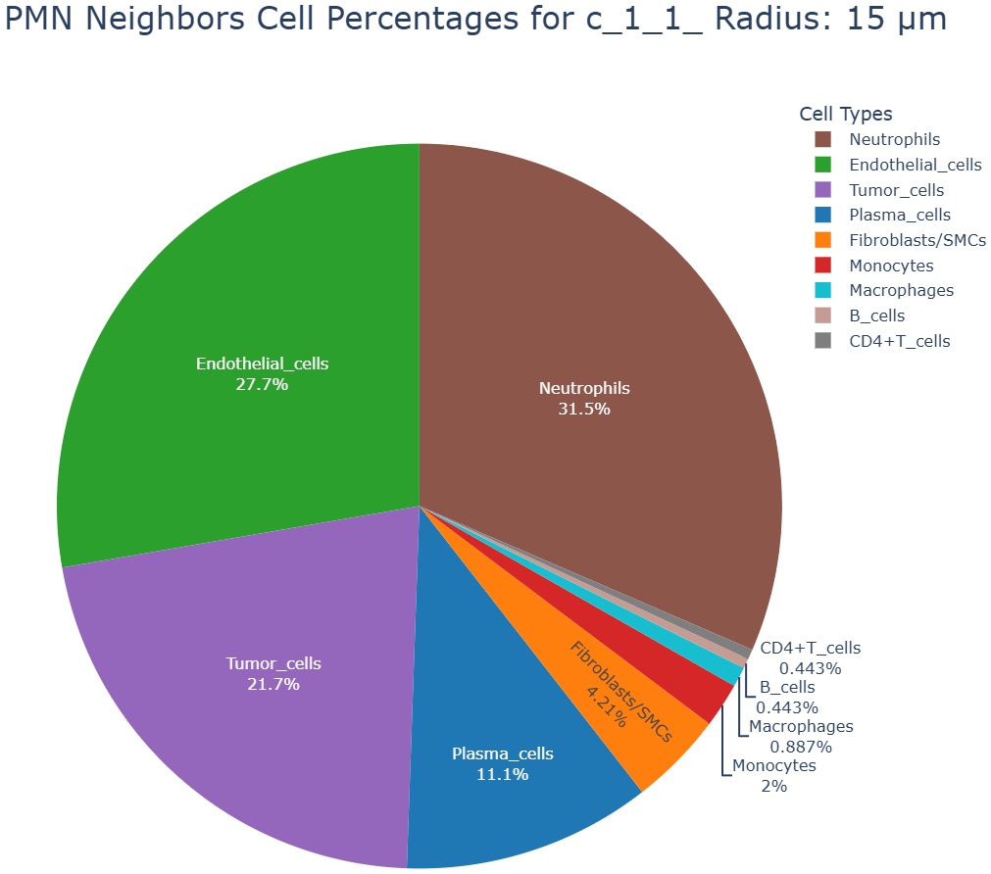
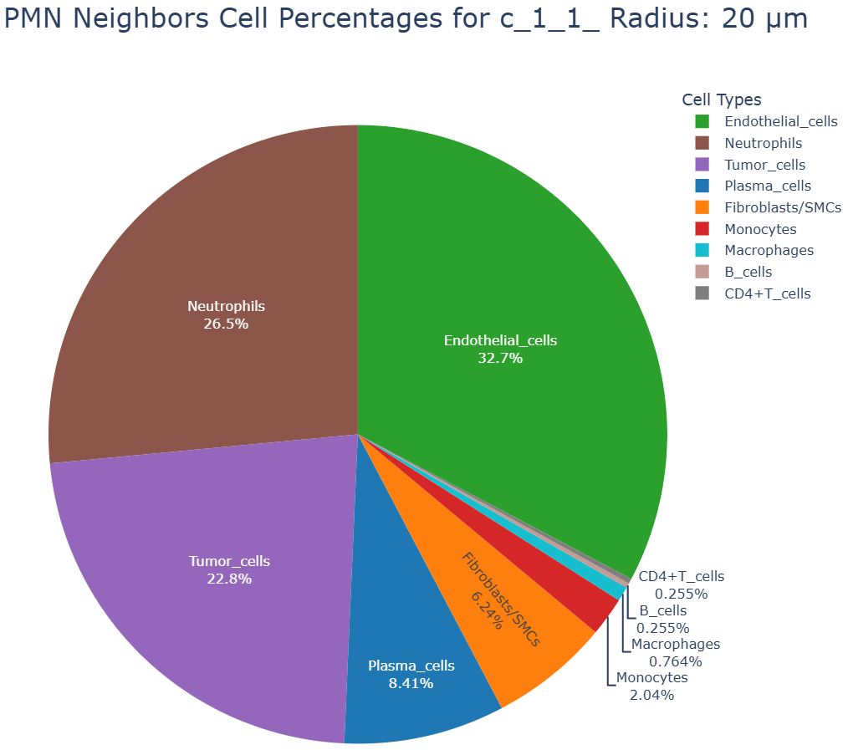
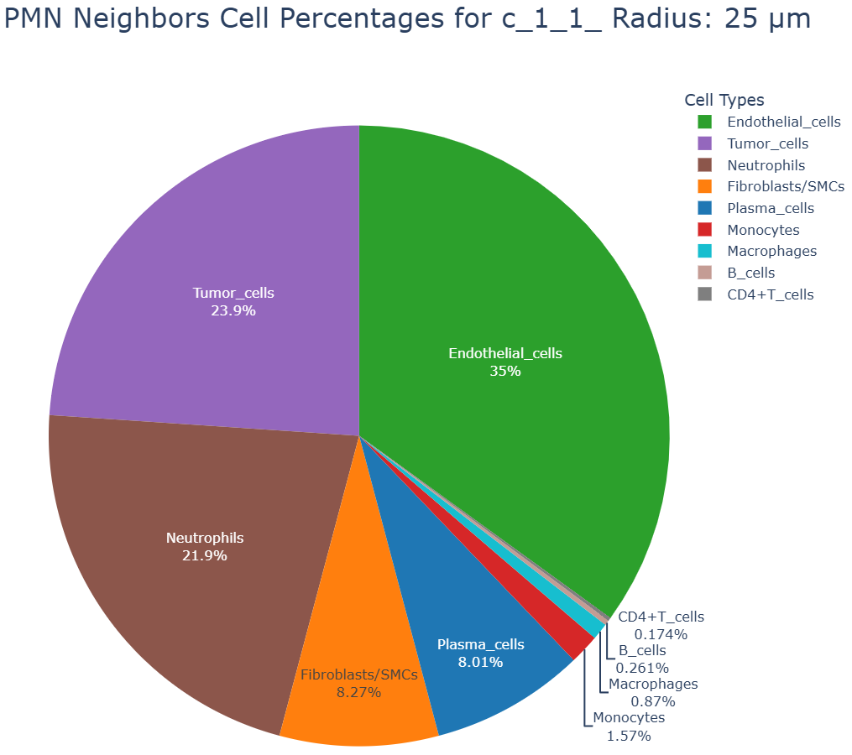
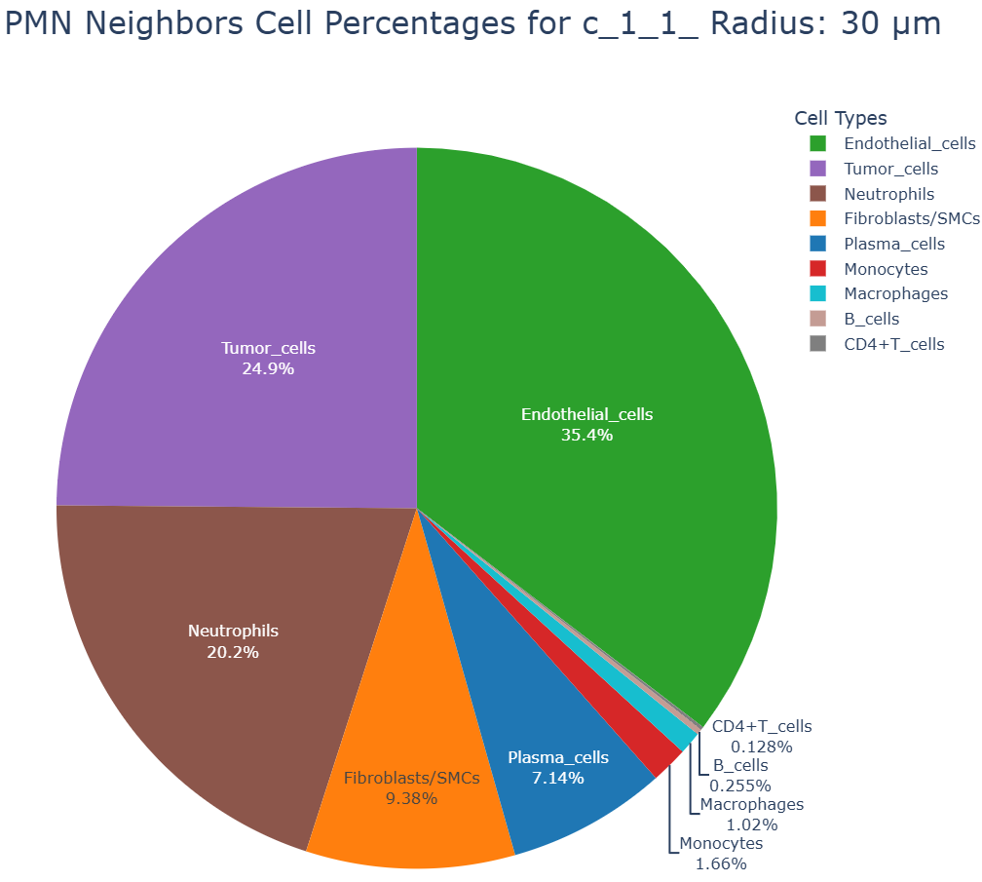
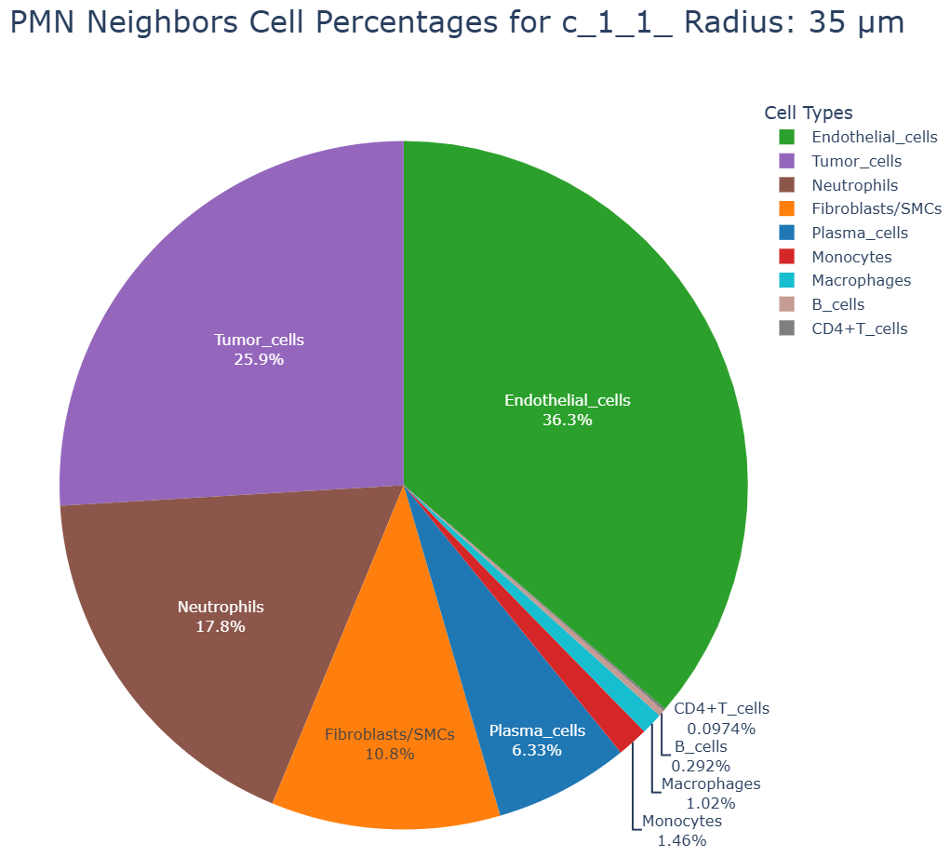
Choosing Radial Distances
Notes:
In literature there does not appear to be a set standard distance used. Most use values between 10-20 um. In the Cell Reports Medicine paper on HNSCC (https://www.sciencedirect.com/science/article/pii/S2666379125001739?ref=pdf_download&fr=RR-2&rr=955e97c87c6cb267) they defined proximal neighbors as within 15 um. In testing different TMA FOVs showed similar values between radial distances 10-20 um. Notably the PMN cells become https://www.sciencedirect.com/science/article/pii/S2666379125001739?ref=pdf_download&fr=RR-2&rr=955e97c87c6cb267

Slide 5
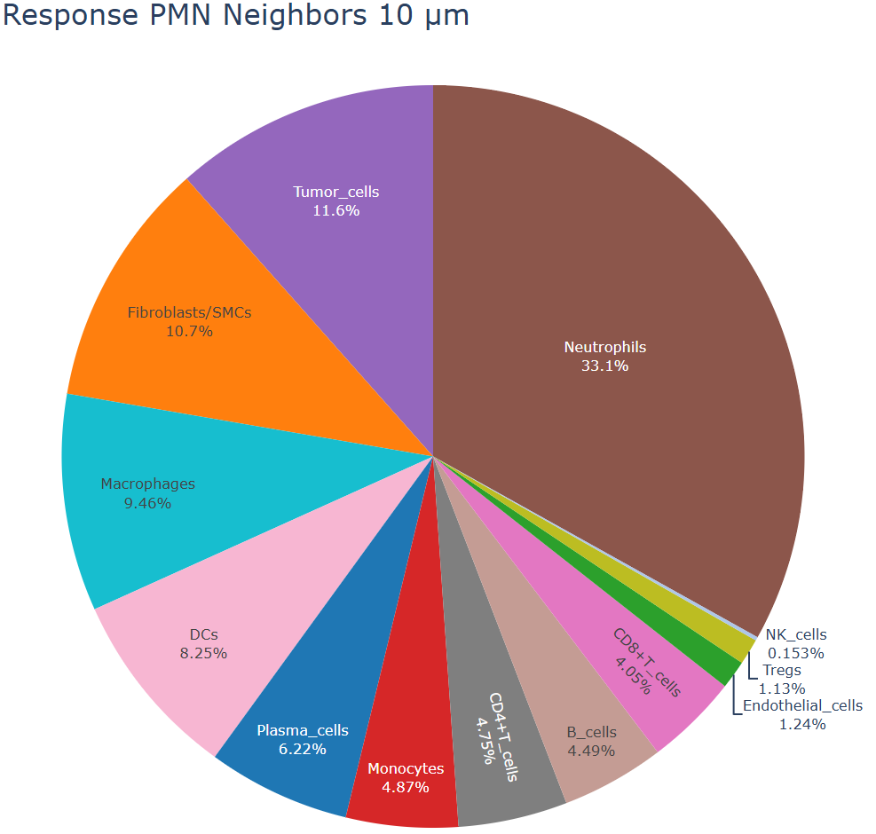
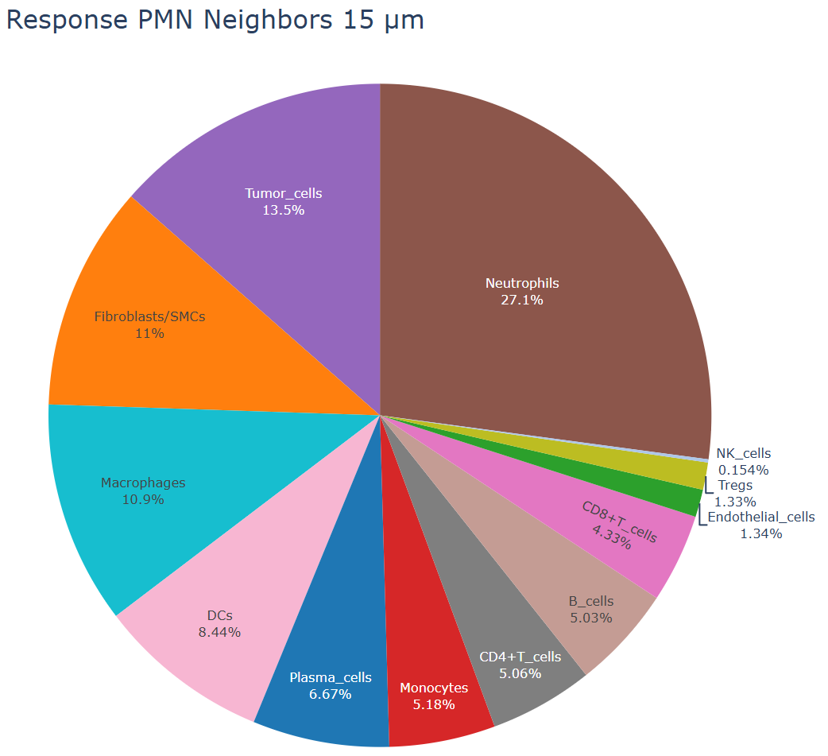
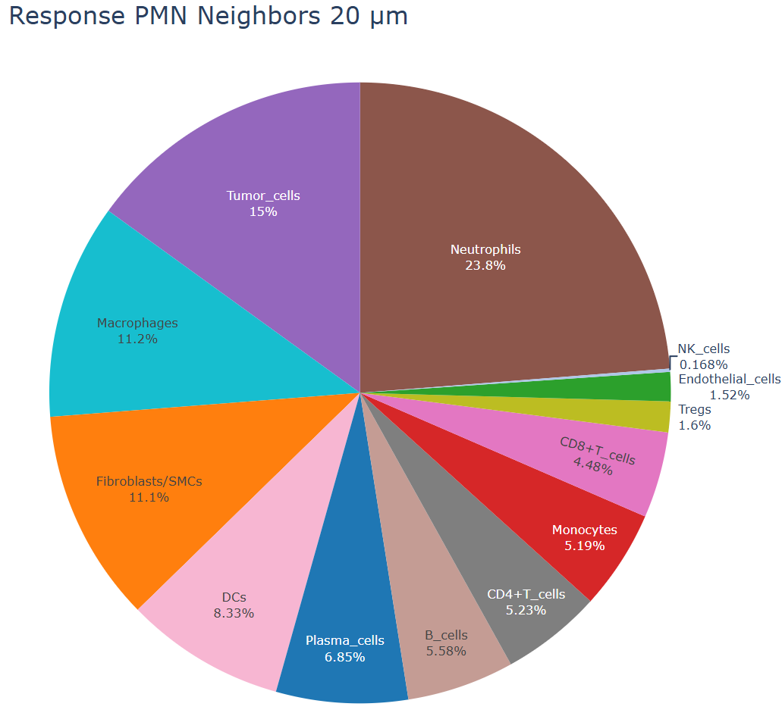
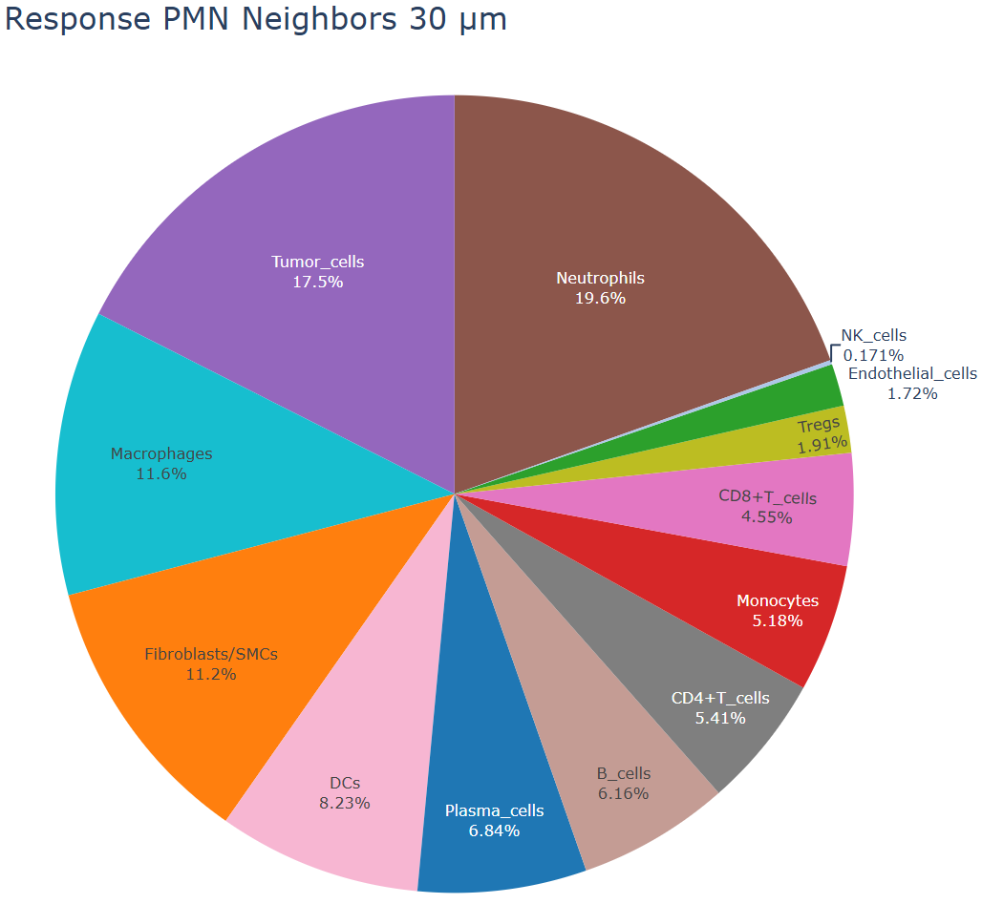
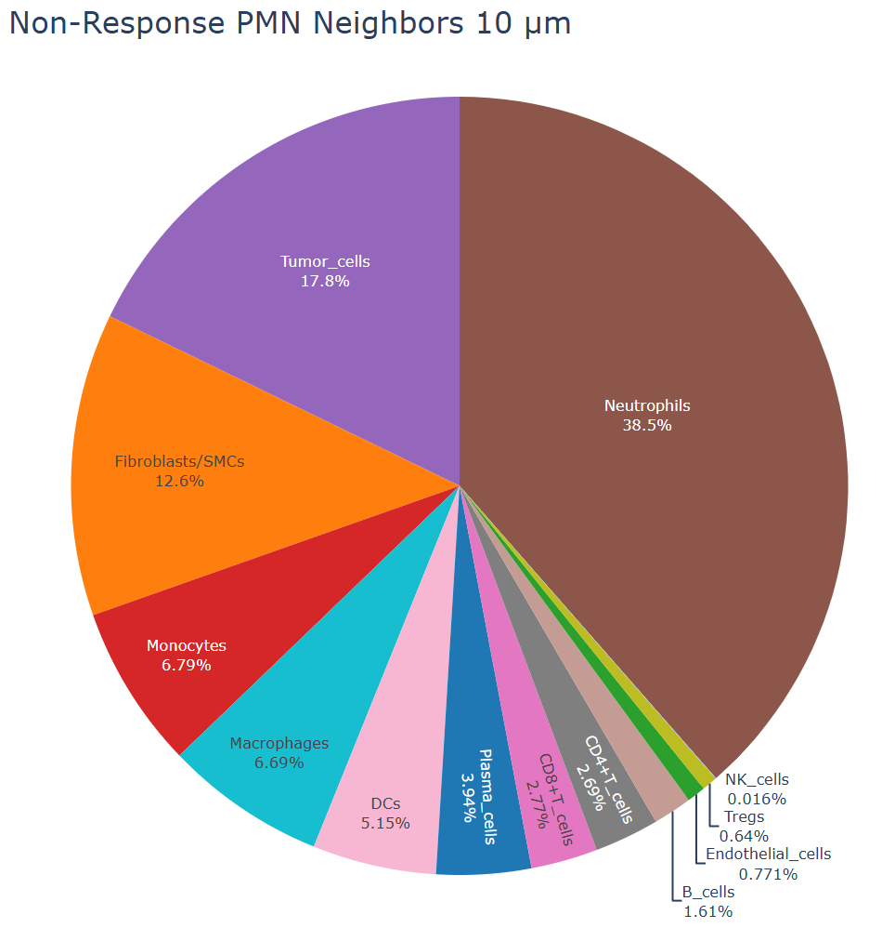
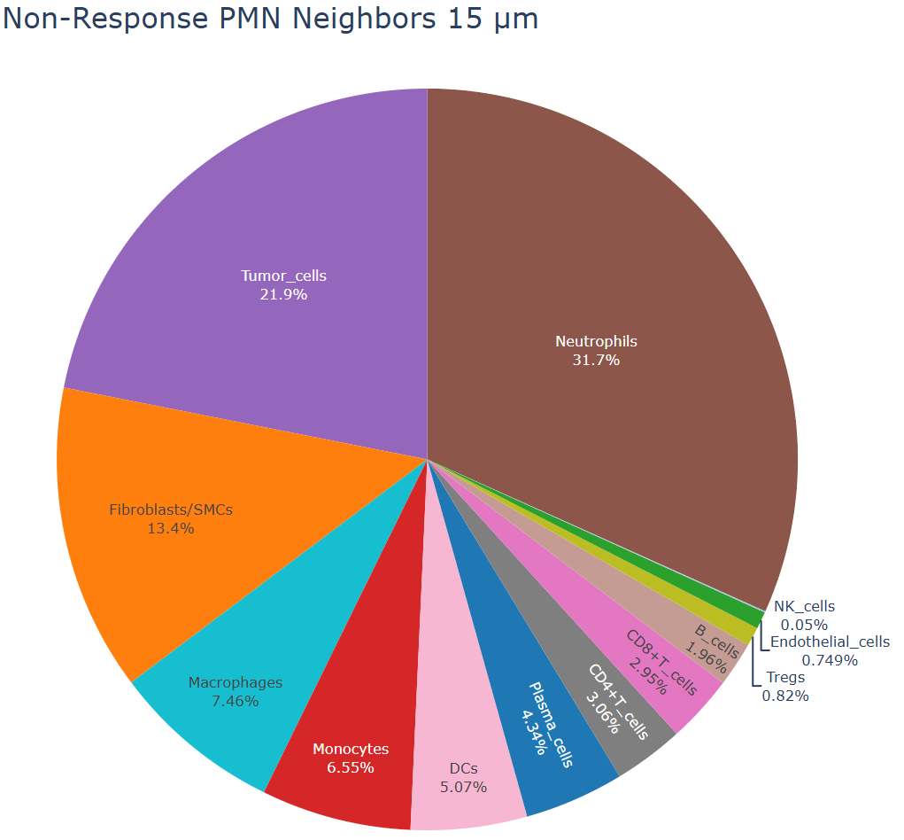
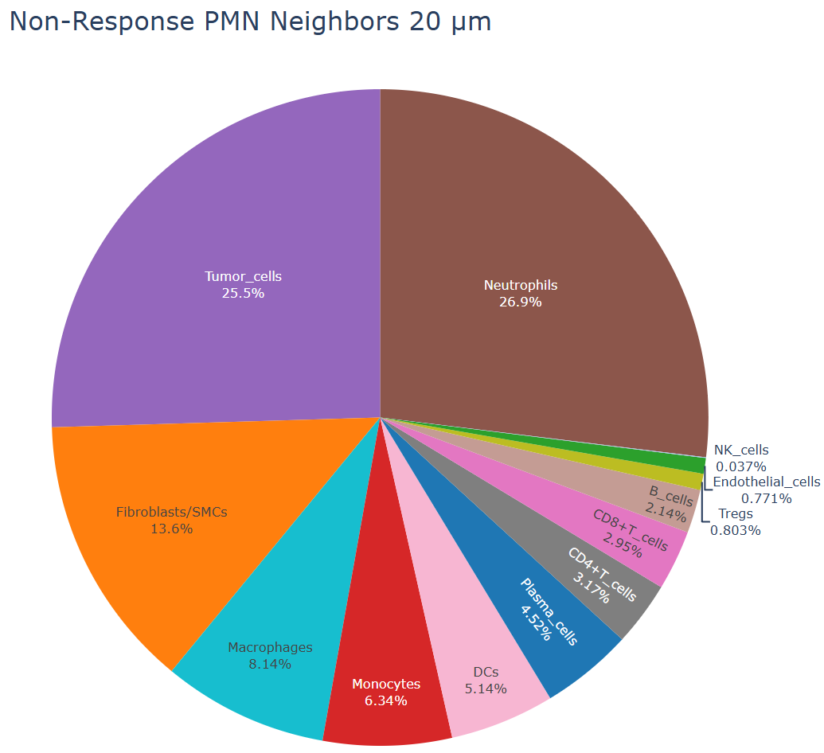
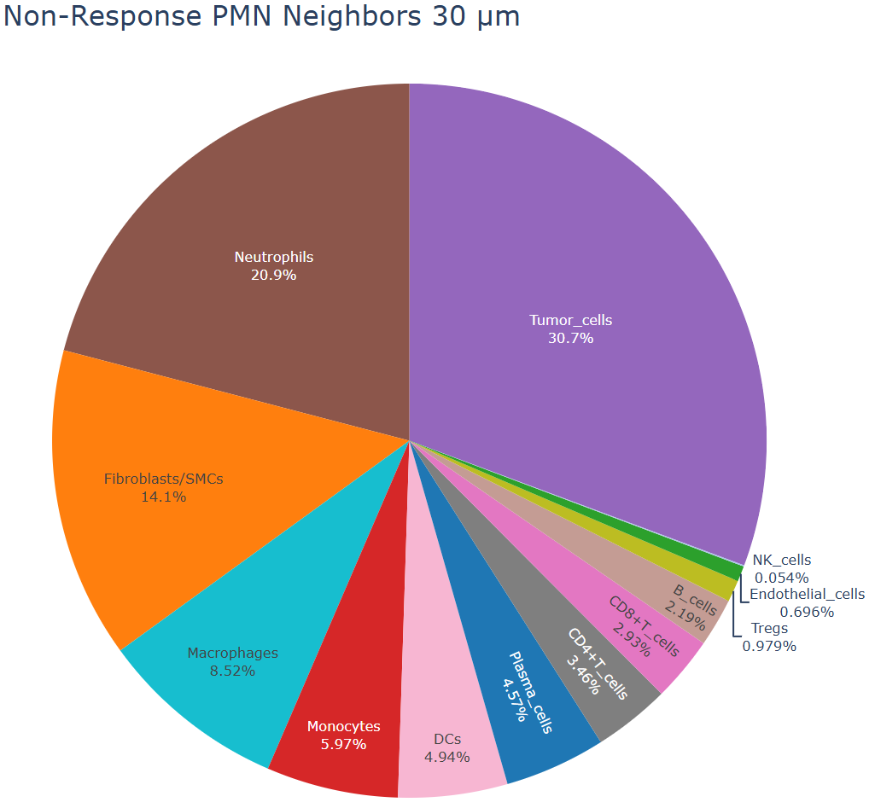
Choosing Radial Distances - Entire Dataset

Slide 6
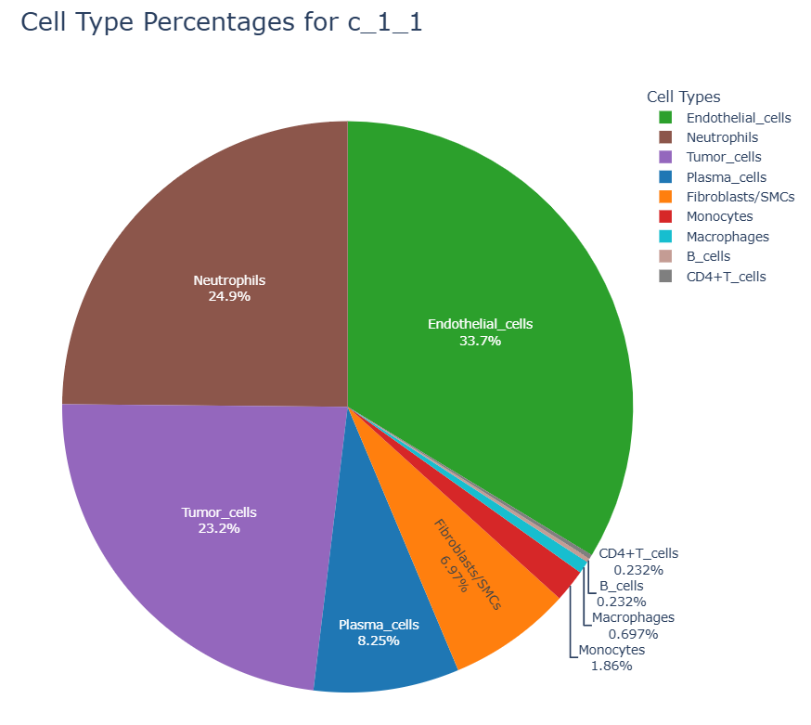
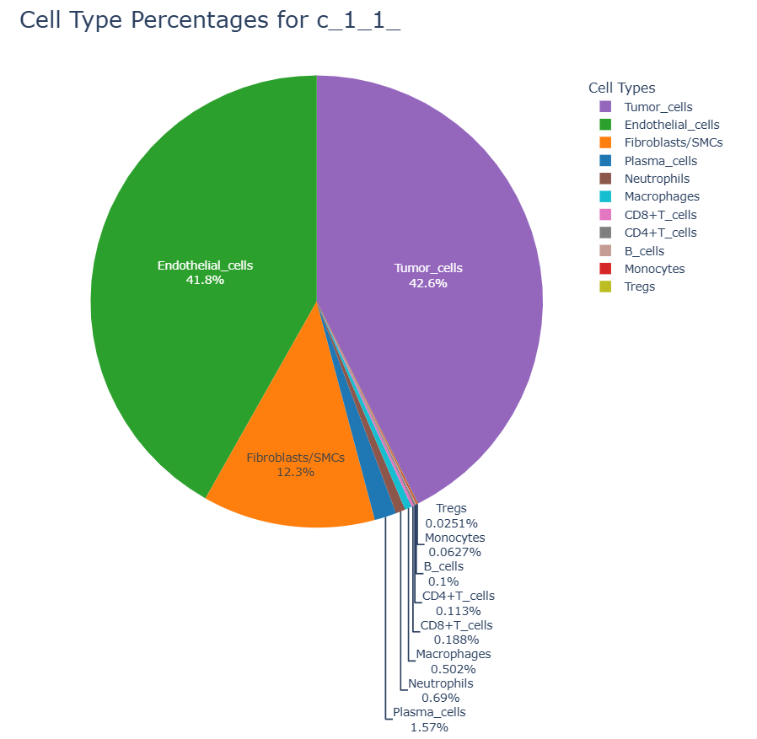
Delta Cell Interaction Percentages
Neighboring Cells
-
Overall Sample Frequency
=
Delta Matrix
PMN = 24.9 – 0.96 =24.16%
Tumor=-19.4%
Endo= - 8.1%
Etc…..

Slide 7
Agenda
Week 5 Review
Radial distance decisions
Delta matrix calculations
Box Plots of cells Neutrophil neighborhood
Neighborhood Plot
Delta Neighborhood Plot
Statistical Significance
Neutrophil Distance Calculations
Methodology
Results

Slide 8
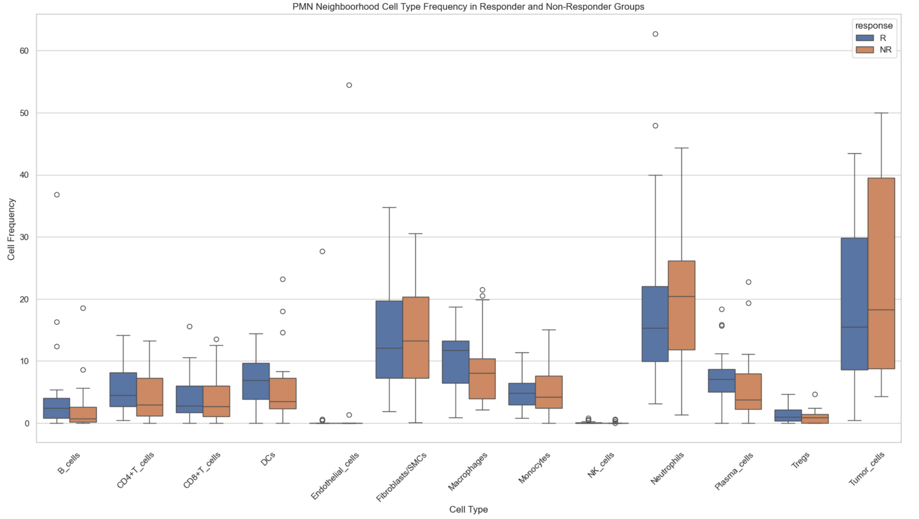
Box Plot of Cellular Neighborhood

Slide 9
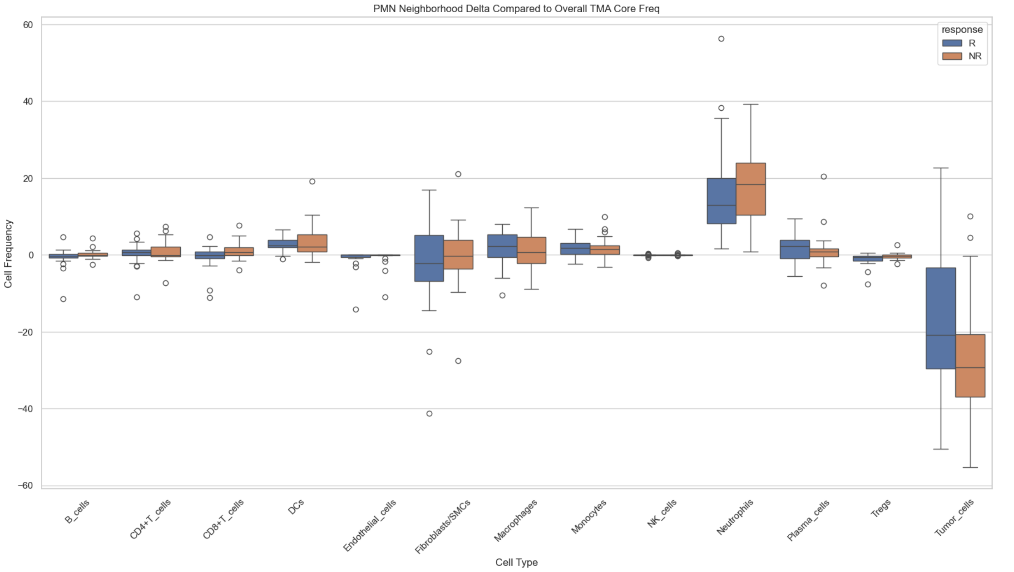
Box Plot of Delta Cellular Neighborhood

Slide 10
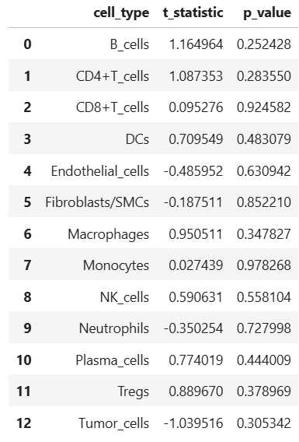
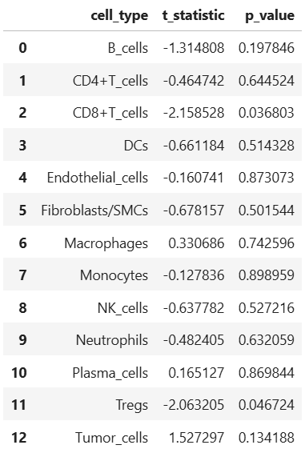
Statistical Significance (Two Tailed T Test)
Delta with overall frequency Matrix R vs NR
Cellular Frequency Matrix R vs NR
Notes:
The delta matrix has far more significant values in general. This is because it removes a lot of variation caused by the overall prevalences of cells.
A positive value of t-statistic indicates that they are more common in responder groups.

Slide 11
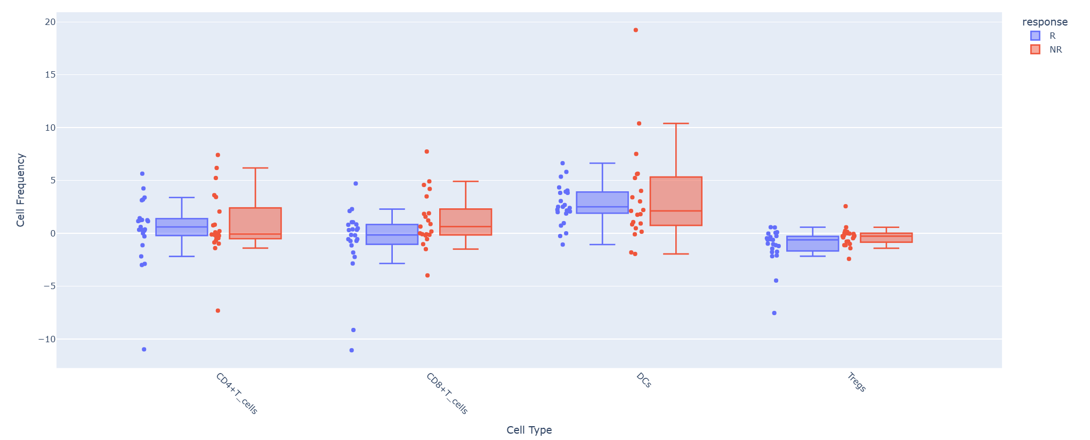
Select Box Plot Neighborhood Delta (Radius = 15 µm)
Takeaways
Non-Responders have fewer CD8 T-cells than responders but are significantly more likely to interact with neutrophils relative to their frequency. (p=0.036) at 15-micron radius.
Non-Responder neutrophils are also significantly more likely to interact with Treg cells than their frequency
No notable difference of neutrophil interaction with CD4 and DCs between NR and R groups.
Note: DCs and B_cells are more common in responders but don’t interact with pmns more than responders.

Slide 12
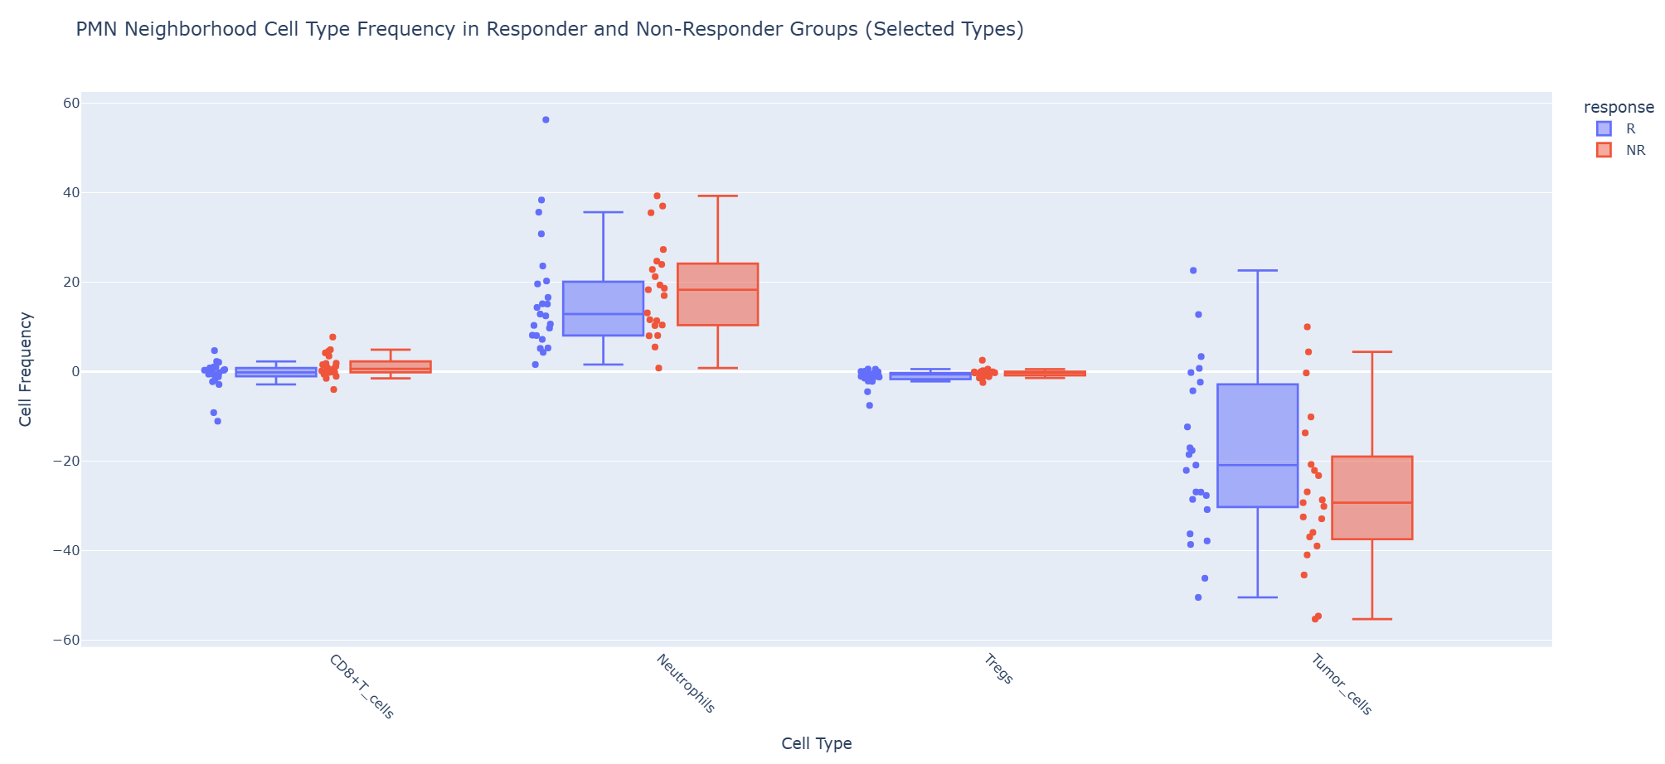
Select Box Plot Neighborhood Delta (Radius = 15 µm)
Takeaways
Higher variation in neutrophil and tumor cells interactions
Responders have higher neutrophil tumor interactions relative to overall frequency. Data is not significant (p=0.13) at 15-micron radius.
Neutrophils clustering is slightly more common in non-responders, but variation is high (p=0.63) at 15-micron radius.

Slide 13
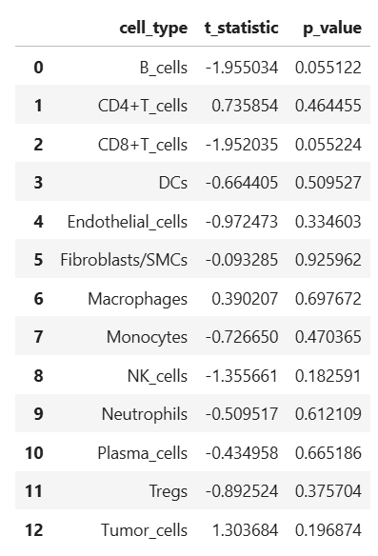
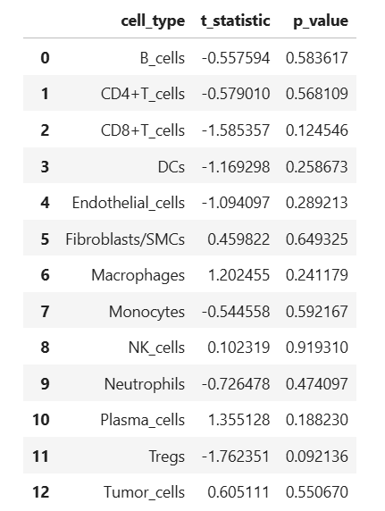
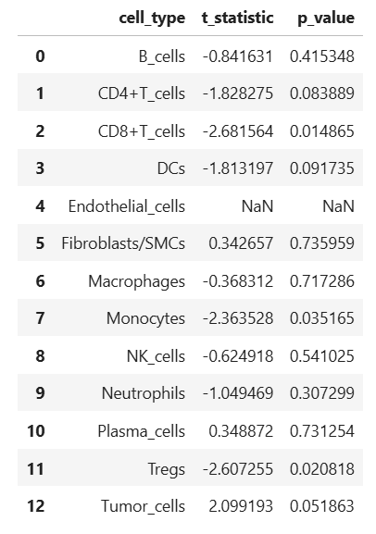
Statistical Significance (Two Tailed T Test)
Delta with overall frequency Matrix R vs NR
PMN>1
PMN>25
PMN>50
PMN>75

Slide 14
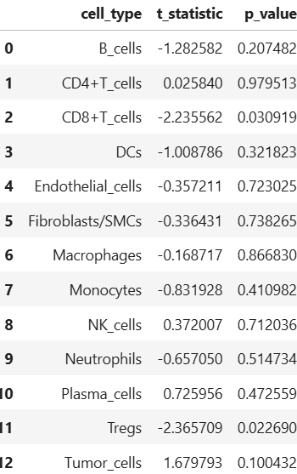
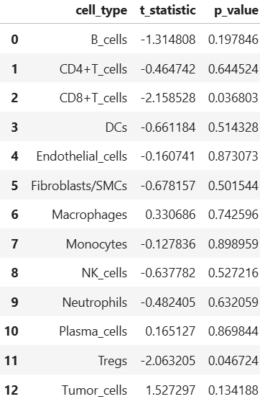
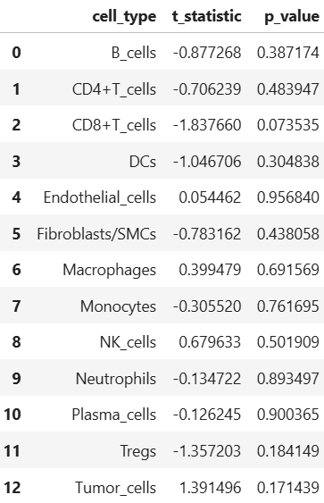
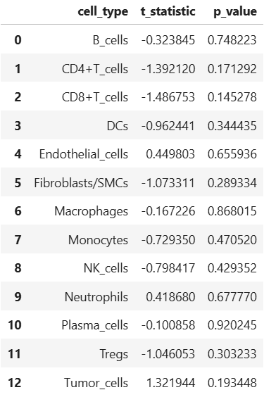
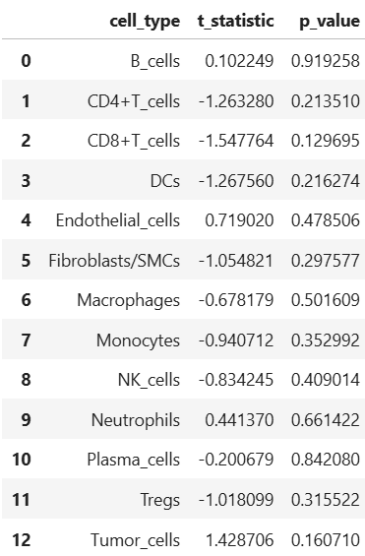
Statistical Significance (Two Tailed T Test)
Delta with overall frequency Matrix R vs NR (PMN>25)
Radius = 10 µm
Radius = 15 µm
Radius = 20 µm
Radius = 30 µm
Radius = 45 µm

Slide 15
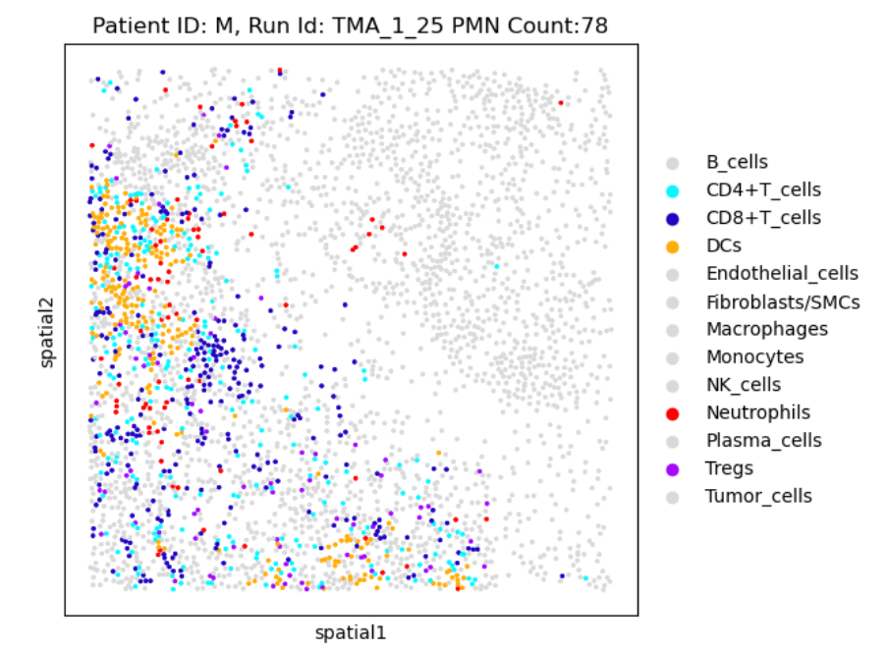
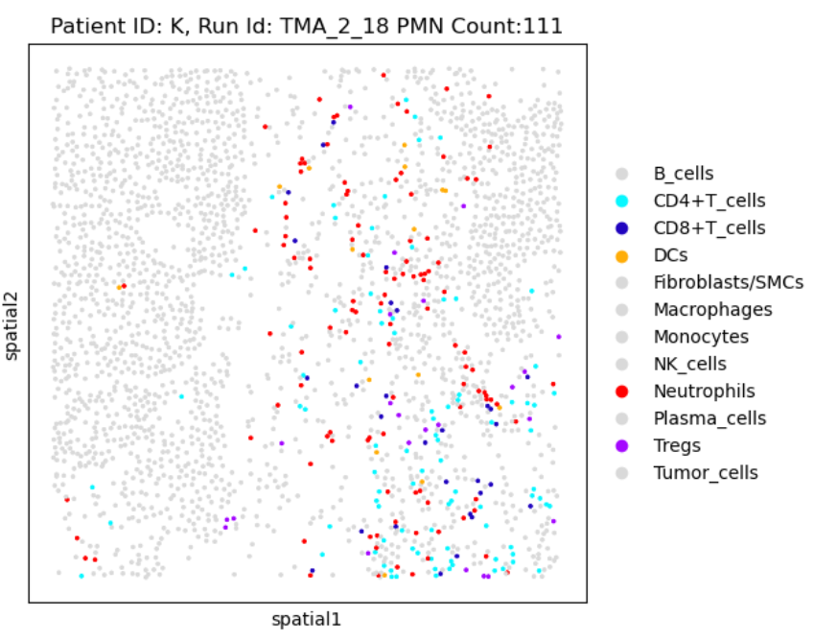
High CD8 and PMN interactions in non responders

Slide 16
Agenda
Week 5 Review
Radial distance decisions
Delta matrix calculations
Box Plots of cells Neutrophil neighborhood
Neighborhood Plot
Delta Neighborhood Plot
Statistical Significance
Neutrophil Distance Calculations
Methodology
Results

Slide 17
PMN Distance Methodology – Example 1
Least Distance Pairwise Method
Minimum Distance Method
Finds shortest distance between each PMN and each target cell
Least Distance Pairwise Method
Creates one-one pairs between PMN and target.
Limited to lesser cell counts
ex: ex if there is 4 PMN cells and 5 target cells there will be only 4 pairs
Uses the Hungarian Algorithm to find least sum of distances
Minimum Distance Method

Slide 18
PMN Distance Methodology – Example 2
Least Distance Pairwise Method
In cases when target cells are much fewer than PMN cells the least distance pairwise method produces shorter distance values
Minimum Distance Method
Minimizing total distance means that the shortest distance isn’t necessarily used

Slide 19
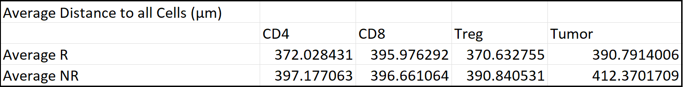
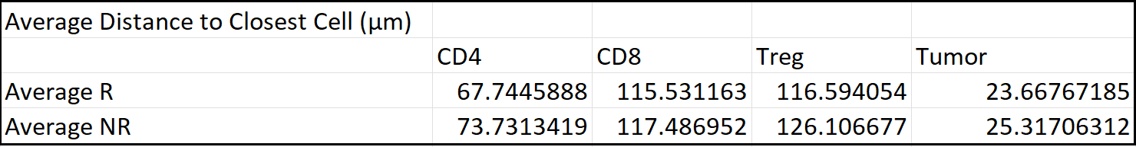
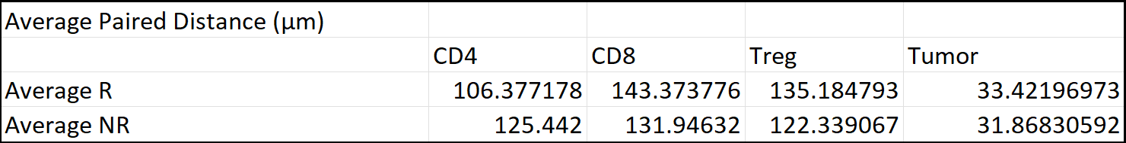
PMN Distance to Immune and tumor cells
No large differences in general. There are a lot of confounding factors.
The neighborhood and delta analysis produce similar analysis
Non responders have closer distances to CD8, Treg cells which aligns with the neighborhood analysis despite higher CD8, Treg frequency in responder groups.

